Slide 1

Knock Knock
An App for Centralised Standard Beat Management System
Presented in India Police Hackathon 2019
By: Doozie Team

Slide 2
ABOUT
Knock Knock - Centralised Standard Beat Management System
Vision
To improve the accuracy of Beat resource conducting the beat using - Face Recognition - Geo Location
Capturing location Photo
Using Tower Signature

Slide 3
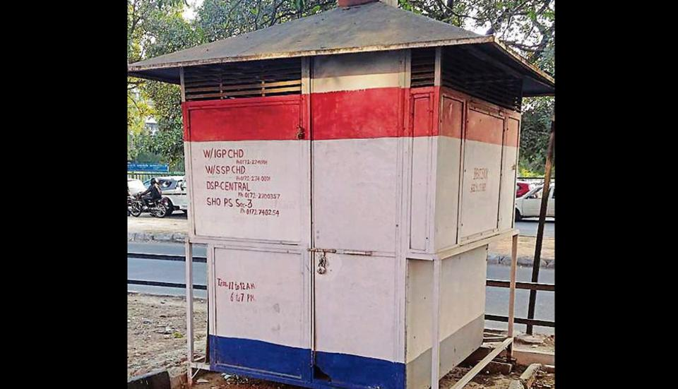
Today’s Problem
Issues faced in Current Beat System
Difficulty in authenticating the same HC/PC going for Beats
Capturing all required information when on Beat
Preparing and utilizing the proper Analytics based on data captured in Beat

Slide 4


Need of Knock Knock
Solution for Current Beat System – Knock Knock APP
Using the current technologies and beat conducting HC/PC’s mobile, Knock Knock apps helps to authenticate that the allotted person is only conducting the beat and also helps to capture all required data which shall be used for analytics later
Technologies Used
Know your schedule and hotspots - marks the locations to be visited using Google Maps
Tower Signature helps to authenticate the PC/HC’s location during information update
Checklist helps in capturing all required information enabling data gathering for analytics
Face recognition helping in authenticating the allotted PC /HC conducting the Beat

Slide 5
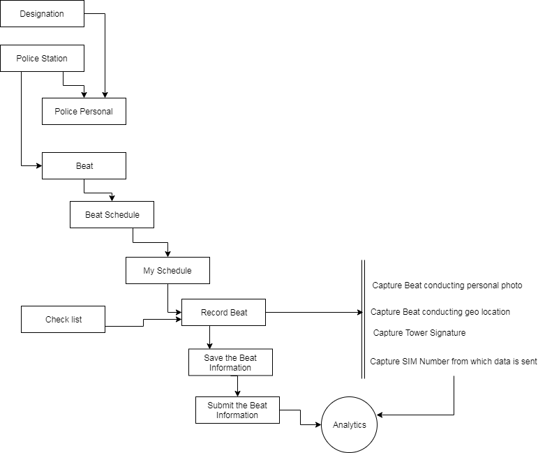
Flow Chart

Slide 6
How it Works
How can I use “Knock Knock” ? (for PC/HC)
Save the Beat for all Points (hot spots) Marked in the beat route
Sign Up
Sign Up / Sign in to the Knock Knock APP
As per the checklist , save the information collected during beat
View Schedule
Cover all / important hotspots
All Schedules will display on login page, attend one by one
Based on checklist , fill the information
Sumbit the Beat information to close the particular Beat
Record the Beat Details
By scanning face, app will let the HC/PC to record the beat details
Sumbitting the Beat plan will close that scheduled beat

Slide 7
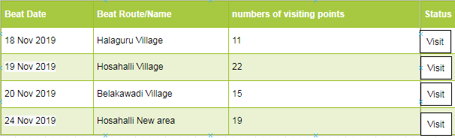
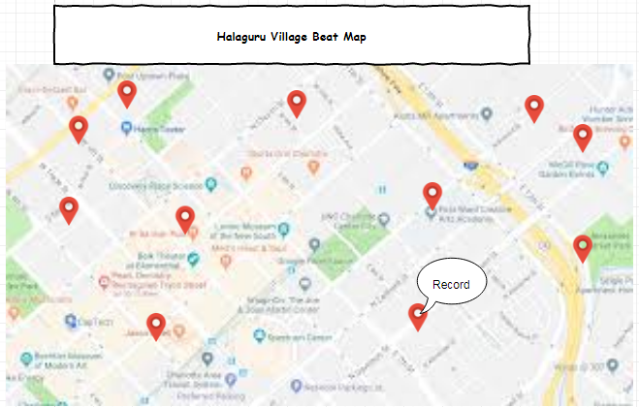
Sample Screen

Slide 8
Technologies
Technologies used to build “Knock Knock”
Python
Cordova
For Face recognition,authentication, analytics
PHP Laravel
Angular
Rest API, Monitoring system
Ionic 4
Google Map API

Slide 9
Proposal
Knock Knock – Other technologies shall be though of
Below are some extra validations could be thought of : - Mobile number validation while updating the beat information with registered Mobile number
- Geo Location capturing and matching with hotspots
Capturing location Photo
Dual photo capture (front with face and back with location)

Slide 10
MEET THE TEAM
WHO ARE BEHIND THE SCENES
Mr. Yogesh D Joshi
Mrs. Sandhya N
Mr. Akshay D joshi
Team Work Works!

Slide 11
THANKS FOR YOUR TIME
QUESTIONS AND QUERIES PLEASE !!

